Slide 1
Angular 4
27-Mar-18 | Start
Appendix
Online

Slide 2
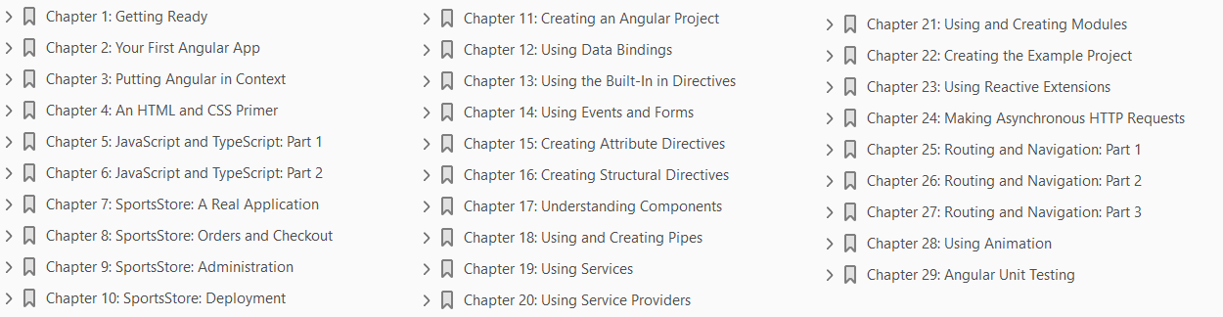
Angular 4
Ch | Date
1 | 05-Apr-18
2
3
4
5
6
7
8
Pro Angular 2017

Slide 3
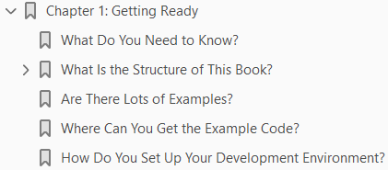
1
Getting Started

Slide 4
Intro
Angular taps into some of the best aspects of server-side development and uses them to enhance HTML in the browser, creating a foundation that makes building rich applications simpler and easier.
Angular applications are built around a design pattern called Model-View-Controller (MVC), which places an emphasis on creating applications that are
Extendable: It is easy to figure out how even a complex Angular app works once you understand the basics—and that means you can easily enhance applications to create new and useful features for your users.
Maintainable: Angular apps are easy to debug and fix, which means that long-term maintenance is simplified.
Testable: Angular has good support for unit and end-to-end testing, meaning that you can find and fix defects before your users do.
Standardized: Angular builds on the innate capabilities of the web browser without getting in your way, allowing you to create standards-compliant web apps that take advantage of the latest features (such as HTML5 APIs) and popular tools and frameworks.
Angular is an open source JavaScript library that is sponsored and maintained by Google.
It has been used in some of the largest and most complex web apps around.
In this book, I show you everything you need to know to get the benefits of Angular in your own projects.

Slide 5
What Do You Need to Know?
Before reading this book, you should be familiar with the basics of web development, have an understanding of how HTML and CSS work, and, ideally, have a working knowledge of JavaScript.
If you are a little hazy on some of these details, I provide refreshers for the HTML, CSS, and JavaScript I use in this book in Chapters 4, 5, and 6.
You won’t find a comprehensive reference for HTML elements and CSS properties, though.
There just isn’t the space in a book about Angular to cover all of HTML.

Slide 6
What Is the Structure of This Book?
This book is split into three parts, each of which covers a set of related topics.
Part 1: Getting Ready – This part provides the information you need to get ready for the rest of the book.
It includes this chapter and primers/refreshers for key technologies, including HTML, CSS, and TypeScript, which is a superset of JavaScript.
I also show you how to build your first Angular application and take you through the process of building a more realistic application, called SportsStore.
Part 2: Working with Angular - Part 2 of this book takes you through the building blocks provided by Angular for creating applications, working through each of them in turn.
Angular includes a lot of built-in functionality, which I describe in depth, and provides endless customization options, all of which I demonstrate.
Part 3: Advanced Angular Features - Part 3 of this book explains how advanced features can be used to create more complex and scalable applications.
I introduce the Reactive Extensions package, which underpins a lot of the functionality provided by Angular and is used directly by advanced features.
I demonstrate how to make asynchronous HTTP requests in an Angular application, how to use URL routing to navigate around an application, and how to animate HTML elements when the state of the application changes.

Slide 7
Are There Lots of Examples?
There are loads of examples.
The best way to learn Angular is by example, and I have packed as many of them as I can into this book.
To maximize the number of examples in this book, I have adopted a simple convention to avoid listing the contents of files over and over again.
The first time I use a file in a chapter, I’ll list the complete contents, just as I have in Listing 1-1.
I include the name of the file in the listing’s header and the folder in which you should create it.
When I make changes to the code, I show the altered statements in bold.
This listing is taken from Chapter 15. Don’t worry about what it does; just be aware that the first time I use a file in each chapter there will be complete listing, similar to the one shown in Listing 1-1.
For the second and subsequent examples, I just show you the elements that change, to create a partial listing.
You can spot a partial listing because it starts and ends with ellipsis (…), as shown in Listing 1-2.

Slide 8
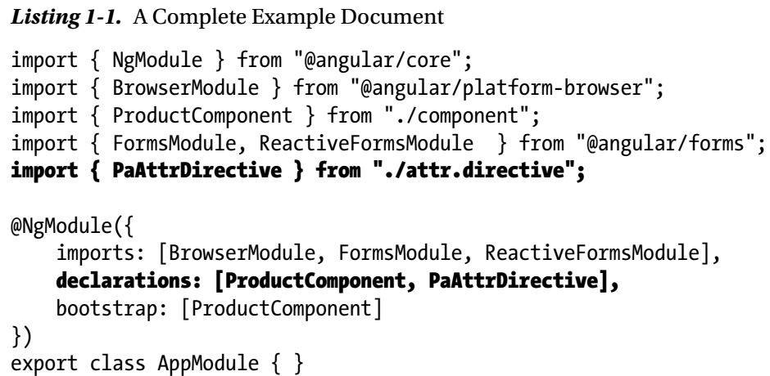
Listing 1-1

Slide 9
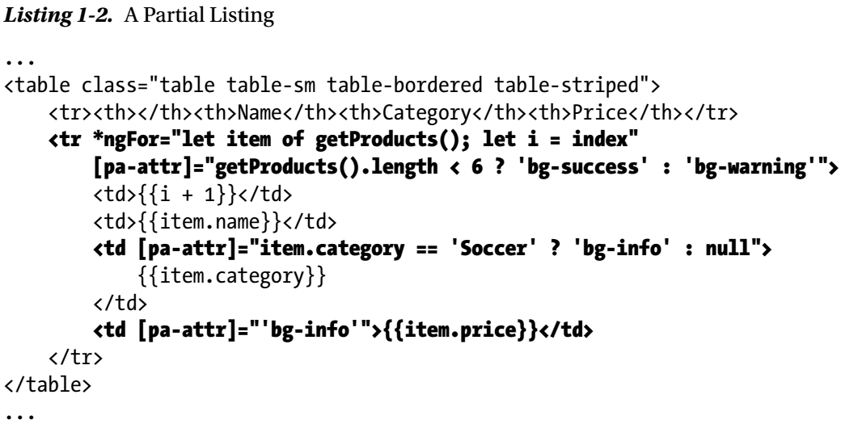
Listing 1-2

Slide 10
Where Can You Get the Example Code?
You can download the example projects for all the chapters in this book from www.apress.com.
The download is available without charge and includes all of the supporting resources that are required to re-create the examples without having to type them in.
You don’t have to download the code, but it is the easiest way of experimenting with the examples and cutting and pasting it into your own projects.

Slide 11
How Do You Set Up Your Development Environment?
Chapter 2 introduces Angular by creating a simple application, and, as part of that process, I tell you how to create a development environment for working with Angular.

Slide 12
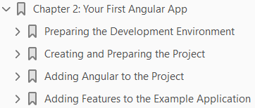
2
Your First Angular App

Slide 13
Intro
The best way to get started with Angular is to dive in and create a web application.
In this chapter, I show you how to set up your development environment and take you through the process of creating a basic application, starting with a static mock-up of the functionality and applying Angular features to create a dynamic web application, albeit a simple one.
In Chapters 7–10, I show you how to create a more complex and realistic Angular application, but for now a simple example will suffice to demonstrate the major components of an Angular app and set the scene for the other chapters in this part of the book.
Don’t worry if you don’t follow everything that happens in this chapter.
Angular has a steep learning curve, so the purpose of this chapter is just to introduce the basic flow of Angular development and give you a sense of how things fit together.
It won’t all make sense right now, but by the time you have finished reading this book, you will understand every step I take in this chapter and much more besides.

Slide 14
Preparing the Development Environment
There is some preparation required for Angular development. In the sections that follow, I explain how to get set up and ready to create your first project.
There is wide support for Angular in popular development tools, and you can pick your favorites

Slide 15
Installing Node.js
Many of the tools used for Angular development rely on Node.js—also known as Node—which was created in 2009 as a simple and efficient runtime for server-side applications written in JavaScript.
Node.js is based on the JavaScript engine used in the Chrome browser and provides an API for executing JavaScript code outside of the browser environment.
Node.js has enjoyed success as an application server, but for this book, it is interesting because it has provided the foundation for a new generation of cross-platform development and build tools.
Some smart design decisions by the Node.js team and the cross-platform support provided by the Chrome JavaScript runtime have created an opportunity that has been seized upon by enthusiastic tool writers.
In short, Node.js has become essential for web application development.

Slide 16
Installing the angular-cli Package

Slide 17
Installing Git

Slide 18
Installing and Editor

Slide 19
Installing a Browser

Slide 20
Creating and Preparing the Project
Once you have Node.js, angular-cli, an editor, and a browser, you have enough of a foundation to start the development process.

Slide 21

Creating the Project
To create the project, select a convenient location and use a command prompt to run the following command to create a new project called todo.
The ng command is provided by the angular-cli package and ng new sets up a new project.
The installation process creates a folder called todo that contains all of the configuration files that are needed to start Angular development, some placeholder files to start development and the NPM packages required for developing, running and deploying Angular applications. (There are a large number of NPM packages, which means that project creation can take a while).

Slide 22
Creating the Package File
NPM uses a file called package.json to get a list of the software packages that are required for a project.
A package.json file is created by angular-cli as part of the project setup and it contains all of the packages requires for basic Angular development.
The example application in this chapter requires the Bootstrap CSS package, which is not part of the basic package set.
Edit the package.json file in the todo folder to add the Bootstrap package as shown in Listing 2-1.
The package.json file lists the packages required to get started with Angular development and some commands to use them.
I describe the project configuration in detail in Chapter 11, but for now, it is enough to understand what each section of the package.json file is for, as described in Table 2-2.

Slide 23
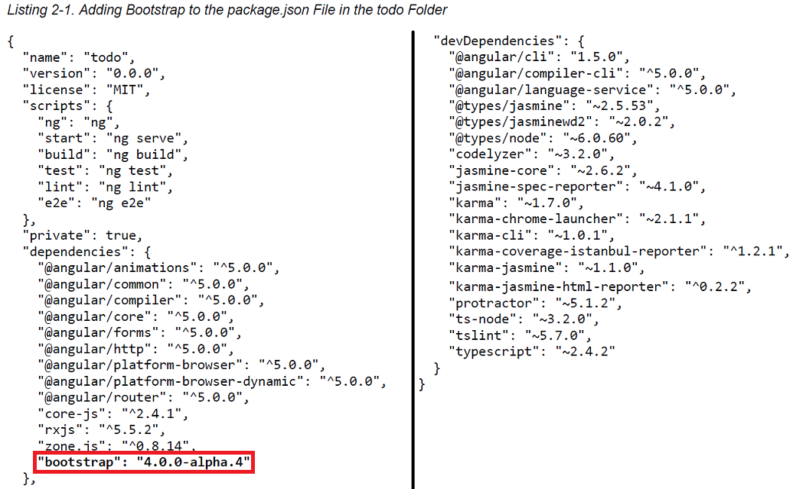
Listing 2-1

Slide 24
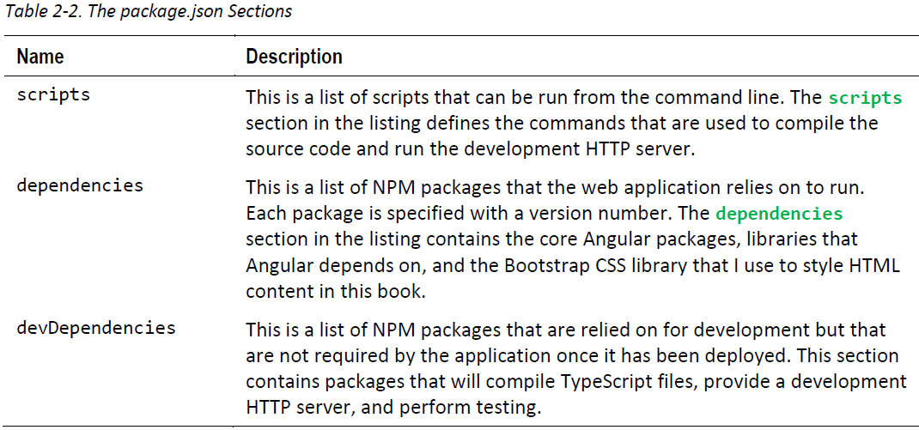
Table 2-2

Slide 25

Installing the NPM Package
To process the package.json file to download and install the Bootstrap package that it specifies, run the following command inside the todo folder:
You may see some warnings as NPM grumbles about the packages it processes, but there should be no errors reported.

Slide 26

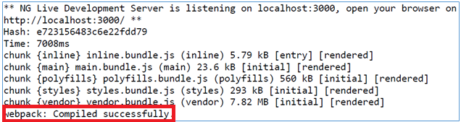
Starting the Server
The project tools and basic structure are in place, so it is time to test that everything is working.
Run the following command from the todo folder:
This command starts the development HTTP server that angular-cli has installed and configured to work with the Angular development tools.
The initial startup process takes a moment to prepare the project, and will generate output similar to this:
Don’t worry if you see slightly different output, just as long as you see the “compiled successfully” message once the preparations are complete.
After a few seconds, a new browser window will open, and you will see the output shown in Figure 2-1, which shows that the project startup has been successful and that the placeholder content created by angular-cli is being used

Slide 27
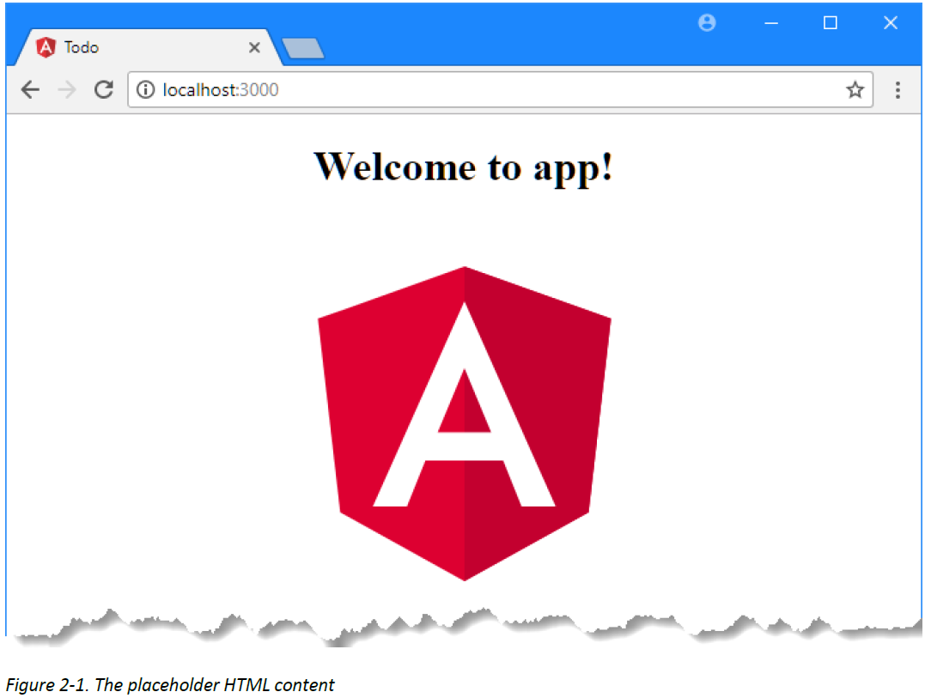
Figure 2-1

Slide 28

Editing the HTML
Even though angular-cli has added some placeholder content, I am going to strip everything back and start with an HTML file that contains static content that I will later enhance using Angular.
The HTML that I am going to use will be styled using the Bootstrap CSS package.
To configure the Angular development tools to provide the browser with the Bootstrap CSS file, add the entry shown in Listing 2-2 to the styles section of the .angular-cli.json file.
Restart the development server by running the following command in the todo folder:
Next, edit the index.html file in the todo/src folder to replace the contents with those shown in Listing 2-3.
The angular-cli development HTTP server adds a fragment of JavaScript to the HTML content it delivers to the browser.
The JavaScript opens a connection back to the server and waits for a signal to reload the page, which is sent when the server detects a change in any of the files in the todo directory.
As soon as you save the index.html file, the server will detect the change and send the signal, and the browser will reload, reflecting the new content as shown in Figure 2-2.

Slide 29
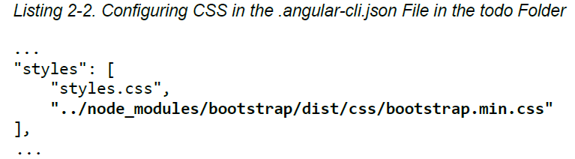
Listing 2-2

Slide 30
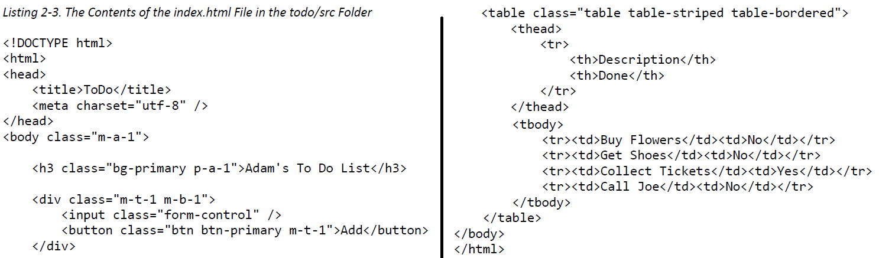
Listing 2-3

Slide 31
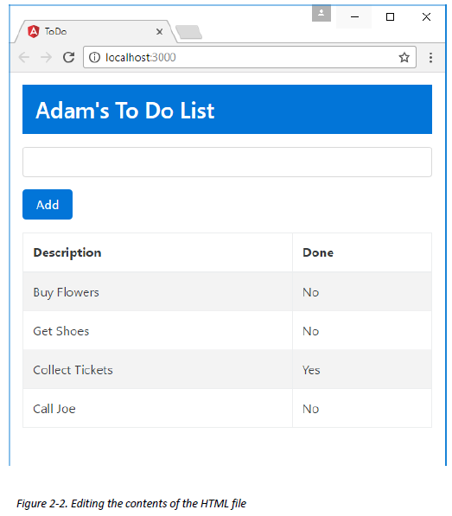
Figure 2-2

Slide 32
Adding Angular to the Project

Slide 33
Adding Features to the Example Application

Slide 34
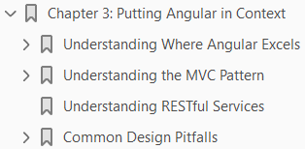
Putting Angular in Context
3

Slide 35
Intro

Slide 36
Understanding Where Angular Excels

Slide 37
Understanding the MVC Pattern

Slide 38
Understanding RESTful Services

Slide 39
Common Design Pitfalls

Slide 40
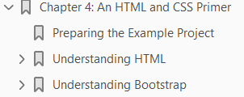
An HTML and CSS Primer
4

Slide 41
Intro

Slide 42
Preparing the Example Project

Slide 43
Understanding HTML

Slide 44
Understanding Bootstrap

Slide 45
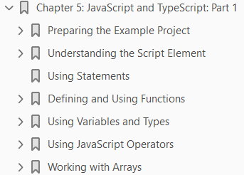
JavaScript and TypeScript: Part I
5

Slide 46
Intro

Slide 47
Preparing the Example Project

Slide 48
Understanding the Script Element

Slide 49
Using Statements

Slide 50
Defining and Using Functions

Slide 51
Using Variables and Types

Slide 52
Using JavaScript Operators

Slide 53
Working with Arrays

Slide 54
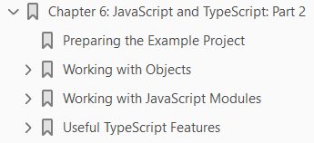
6
JavaScript and TypeScript: Part 2

Slide 55
Intro

Slide 56
Preparing the Example Project

Slide 57
Working with Objects

Slide 58
Working with JavaScript Modules

Slide 59
Useful TypeScript Features

Slide 60
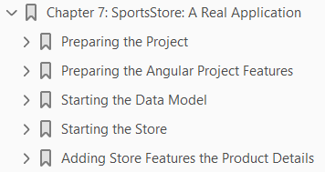
SportsStore: A Real Application
7

Slide 61
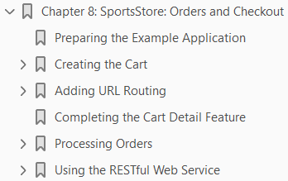
SportsStore: Orders and Checkout
8

Slide 62
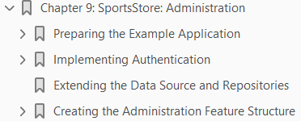
SportsStore: Administration
9

Slide 63
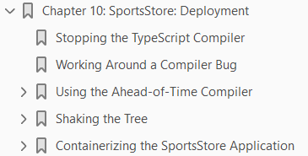
SportsStore: Deployment
10

Slide 64

Creating an Angular Project
11

Slide 65
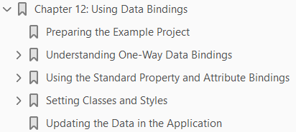
Using Data Bindings
12

Slide 66
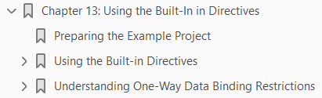
Using the Built-in Directives
13

Slide 67
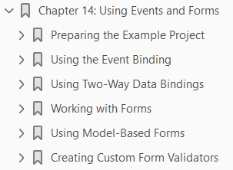
Using Event and Forms
14

Slide 68
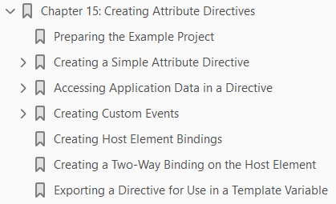
Creating Attribute Directives
15

Slide 69
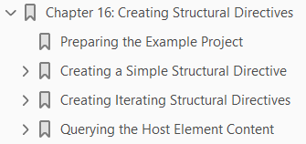
Creating Structural Directives
16

